Slide 1

List of Contents
01.
Problem statement
02.
3D Drawings
03.
System Components
04.
Objective
05.
Description

Slide 2
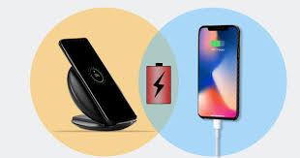
PROBLEM STATEMENT
Develop an effective inductive mobile charging system that offers fast, reliable wireless charging for devices, while being cost-effective, safe, and user-friendly.

Slide 3
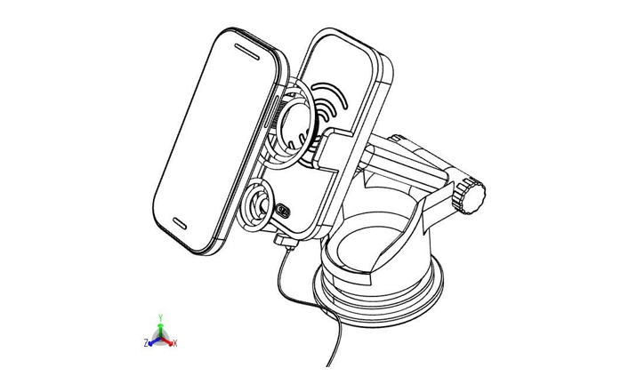
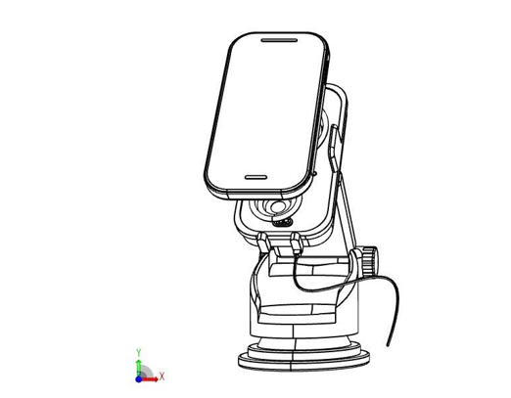
3D DRAWINGS
Isometric view
Front view

Slide 4
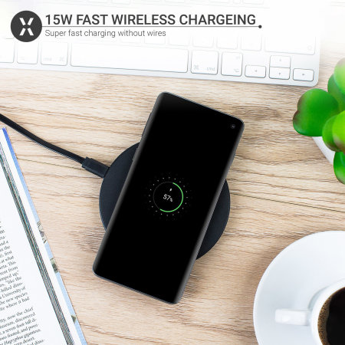
SYSTEM COMPONENTS
Bottom Stand:
Placed on the floor, the stand holds the wireless charger and has solar panels to generate electricity from sunlight
Mobile Charger:
The transmitter generates an oscillating magnetic field, while the receiver in the phone converts it into usable electricity for charging.

Slide 5
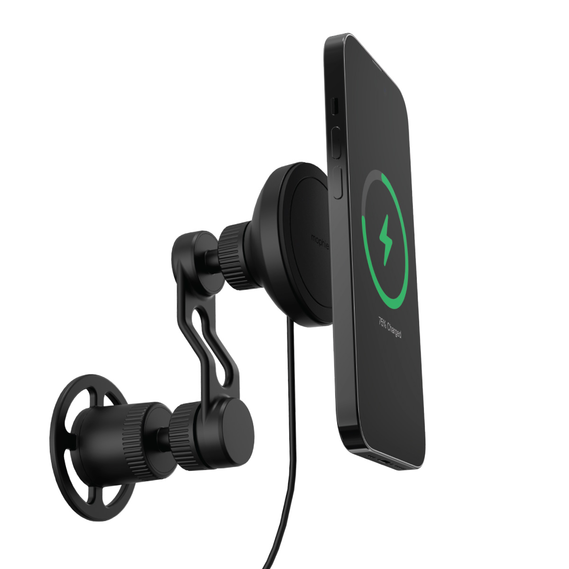
Bluetooth Communication:
Establishes a connection between the transmitter and receiver units to facilitate wireless power transfer.
Roller Mechanism:
Adjusts the angle and position of the transmitter and receiver units to maximize energy transfer.
Automatically self-adjusts the direction/angle to minimize power loss during charging.
Read More

Slide 6

OBJECTIVE
Wireless Charging: To improve power transfer efficiency without energy losses.
Angle/Position/Direction Adjustability: To reduce transmission losses during energy transfer.
Solar Energy Utilization: To harness solar power for wireless charging of mobile phone batteries.

Slide 7
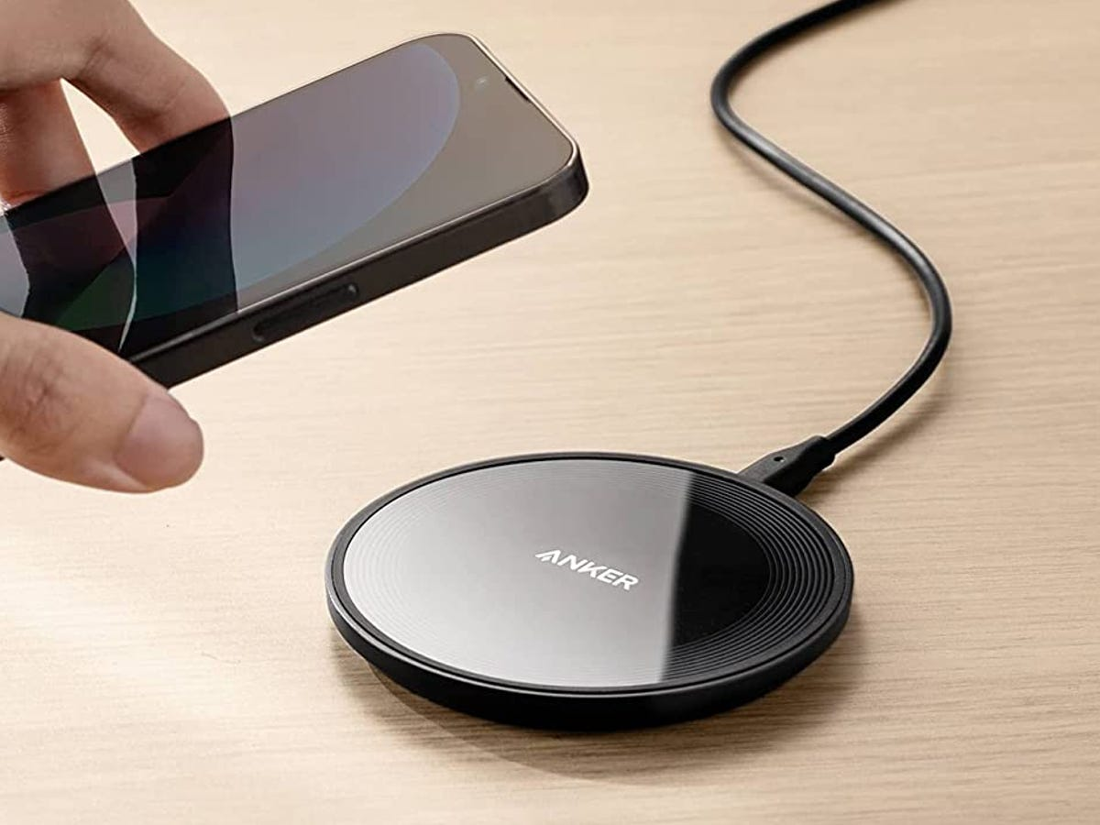
Eco-Friendly and Convenient Charging: To provide an environmentally friendly charging option that fits into daily life.
Charging Distance: To enable mobile charging up to 10 meters using transmitter and receiver units.
Minimizing Carbon Emissions: To lower emissions and dependency on non-renewable energy by incorporating solar power.
Read More

Slide 8

DESCRIPTION
Eliminates Wires: By leveraging wireless charging, the system reduces the need for physical connectors, which enhances user mobility and convenience.
Solves Accessibility and Mobility Issues: Unlike wired connections, a wireless system allows users to charge their devices without being tethered, thus offering greater flexibility
Read More

Slide 9
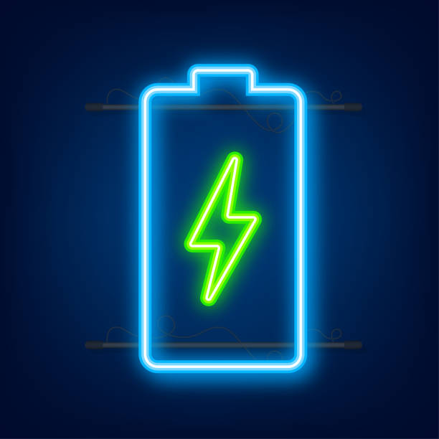
Improves Charging Efficiency:Adjustable angle and position features can fix alignment issues in current wireless chargers, reducing energy loss and improving charging performance.
Reduces Environmental Impact: Solar power as a source of energy can reduce reliance on non-renewable energy sources, potentially lowering environmental pollution associated with traditional energy production.

